Slide 1

Serial Music Maker
Demonstration for Final Year Project
By Ziwei .Lin

Slide 2
Contents
Introduction – Aim and Features
Software Description – Components and Technologies
- GUI – Java Swing
- Algorithm Implementation – Java OO Programming
- Music generating and output - MIDI Programming
Music Sheet generation – Lilypond configuration & call cmd.exe and perform commands in Java
Plan Reviewing
Ethical Use of Data
Software Demo
Q&A

Slide 3
Introduction - Aim
Music Composing Experiments
for Professional Users
To Implement
Melody Serialism: Schoenberg’s 12-Tone Theory
Rhythm Serialism: Babbitt’s Duration Row System & Time Point System
Volume Serialism

Slide 4
Introduction - Features
Support a GUI
Implement 12-tone composing technique
Implement Duration Row System and Time Point System
Implement Volume Alternation
Enable MIDI Output
Enable Sheet Music Output

Slide 5
Software Description Components & Technologies

Slide 6
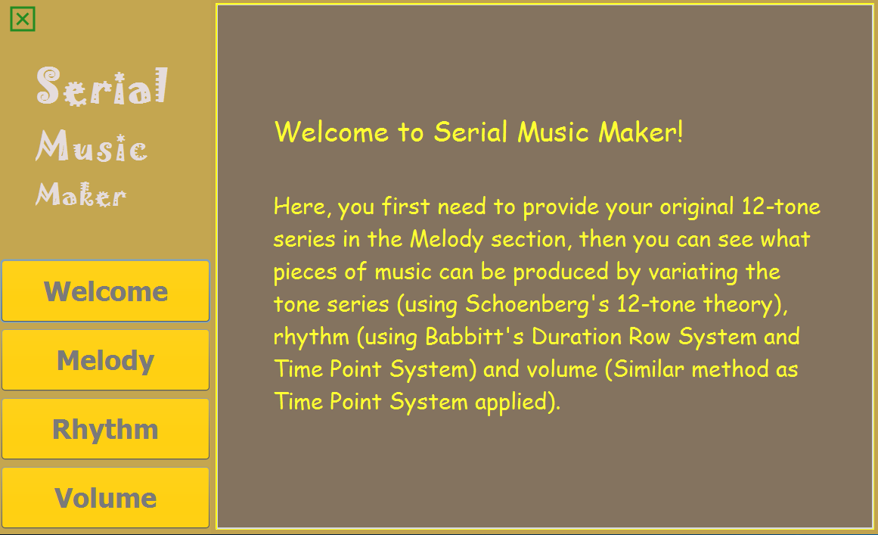
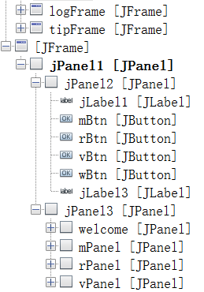
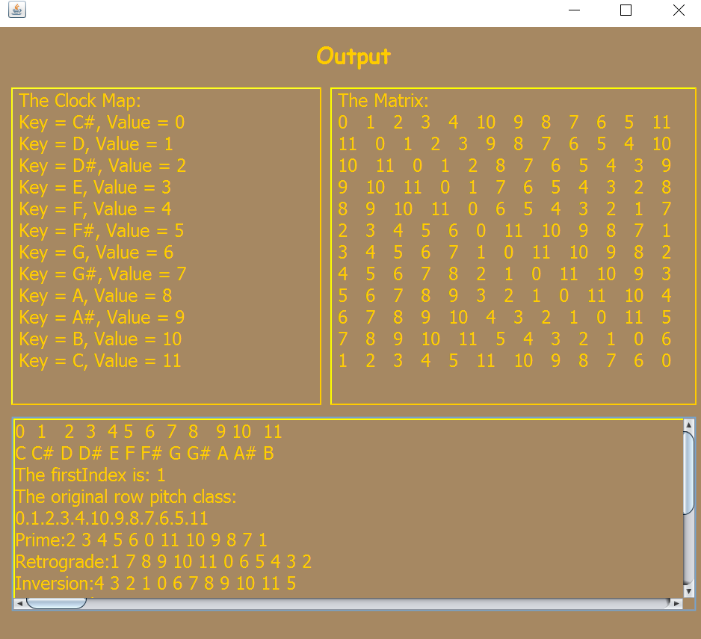
GUI – Java Swing Use NetBeans IDE (offers GUI Builder)
Swing Components

Slide 7
Algorithm Implementation Melody Serialism
Melody – A Series of Pitches
Pitch class – Pitches under octave equivalence
Totally 12 pitch classes:
C C# D D# E F F# G G# A A# B
Atonal Music:
No pitch is more important than other pitches.
Schoenberg repeat 12-notes pattern to make melody – use 12-tone Matrix
Schoenberg

Slide 8


Algorithm Implementation Melody Serialism
Generate 12-tone Matrix
Input Original Pitch Row
Pitch Clock: assign 0~11 to each Pitch
0 to the first tone in the original row
others are assigned in chromatic scale order
3.
Prime (P)
Retrograde-Inversion (RI)
Schoenberg
Inversion (I)
Retrograde (R)

Slide 9
Algorithm Implementation Melody Serialism
Generate Melody
Randomly choose one P I R RI series each
Repeat each series 4 times to form the
“wholeList” of 12* 4 * 4 = 192 tunes.
(Each tune is a number = 0~11 + random * 12)
MIDI Notes: 0~127, Middle C = C4 = 60.
ArrayList segments – the way to separate
wholeList as sounds of 1~4 tunes.
ArrayList<ArrayList> originList – List of chords
(group tunes according to “segments”).
ArrayList<ArrayList> MelodySoundList –
“originList” +[] (pauses) to fit Son Clave
rhythm (31[2]2[2]24).
Schoenberg

Slide 10
Algorithm Implementation Rhythm Serialism
Duration Row Rhythm
Simply use Minuet (Bach) as melody
Take in 3 durations (1~12) as original duration row
Add 3 to each durations and form a new duration
row (Subtract by 12 if the duration >12)
As one bar has 12 units’ duration, if the (sum of a
duration row) %12 != 0, the rest time before the next
bar line will be a pause.
ArrayList <ArrayList> MinuetDurationRow – Minuet
+ pauses [] according to the durationRow duration.
Babbitt

Slide 11
Algorithm Implementation Rhythm Serialism
Time Point Rhythm
Use Minuet (Bach) & MelodySoundList melody
Different from Duration Row System, the duration
row stands for the duration of pause between
the previous bar line and the current tune.
ArrayList minuetTPDuration & tpDurations –
convert the pause duration to the actual duration
of each tune.
ArrayList <ArrayList> minuetTimePoint &
timePointList – Minuet + pauses [] according to
“minuetTPDuration”.
Babbitt

Slide 12
Algorithm Implementation Volume Serialism
No typical method for volume serialism
Just use the same method as how the
duration row is generated.
Consider 11 as fffff and 0 as ppppp.
Apply the volume on Minuet and “timePointList”.

Slide 13
Music Generating & Output MIDI Programming
Javax.sound.midi.* Package
Synthesizer: software for midi play
Sequencer: take midi data and command
instruments to play the notes
Channel: take midi event and synchronized
by the sequencer
Track: a sequence of MidiEvents
Sequence: contain multiple tracks and
timing information, played by
the sequencer.
Command: 144 Note on; 128 Note off.

Slide 14
Music Generating & Output MIDI Programming
Can write MIDI File
MidiSystem.write(Sequence, int, File).
Can use Sequencer open and start playing
MIDI file.

Slide 15

Music Sheet Generation LilyPond & Command
LilyPond – Free software to produce sheet music
By downloading and configuring the
environment variable, Lilypond can be
executed in cmd.exe.
Runtime.getRuntime().exec() [run cmd.exe]
$ midi2ly file.midi –output file.ly [midi to ly]
$ lilypond file.ly [ly to pdf sheet / midi]

Slide 16
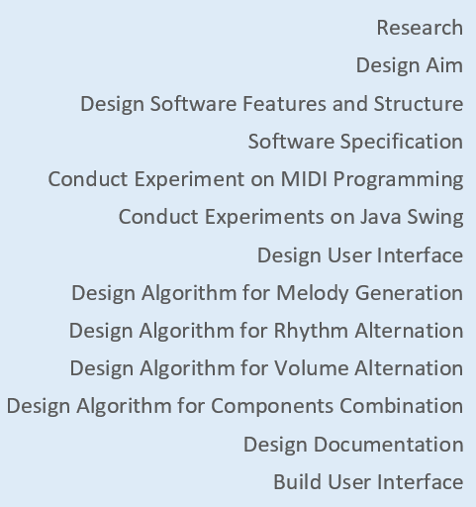
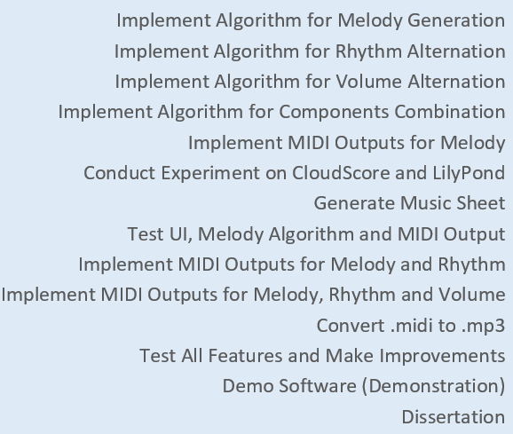
Plan Reviewing
Initial Plan

Slide 17
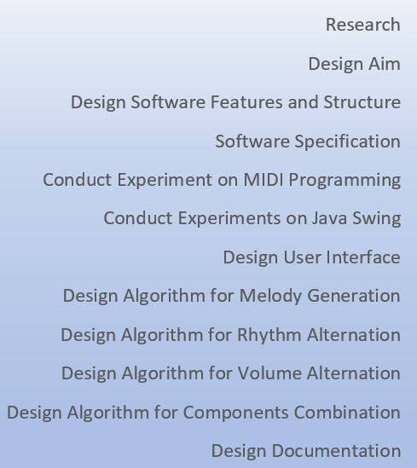
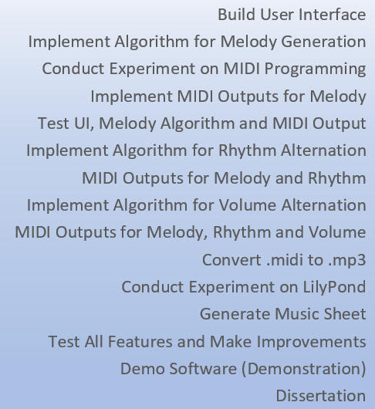
Plan Reviewing
Current Plan

Slide 18
Plan Reviewing
Current Progress
.mp3 belongs to audio file, generated by recording the acoustic or electronic waveform. They are real world sound.
.midi is generated by keyboard enter, the signal is data about which key and when to press. MIDI signal can only be played by connecting to a sound generator.
Have not found way to convert MIDI File to Audio File using Java. Currently using Java.net to open a third party (Zamzar) webpage to convert .midi to .mp3.

Slide 19
Ethical Use of Data
This project does not involve
any human participant’s data.

Slide 20
Software Demo + Q&A

